Slide 1
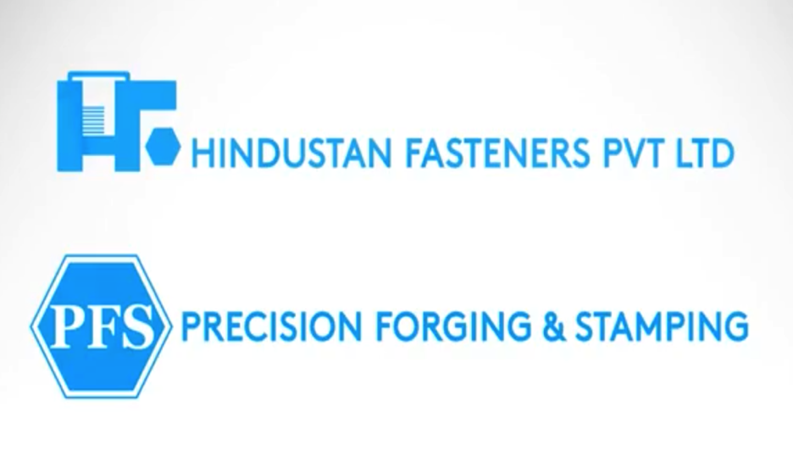

Slide 2


Company Profile
Hindustan Fasteners Precision Forging and Stamping
Established | Hindustan Fasteners In 1970 & Precision Forging and Stamping In 1982
Product | Cold and Hot Formed High Tensile Fasteners and Parts
Sales Turnover | FY 19-20 Rs 120 Cr
Quality Certification | IATF 16949-2016
Employee Strength | 500
Production Capacity | 36000 MT p.a
Customer Segments | Automotive, Industrial, Agricultural, Construction, Defense, Electrical, Aftermarket
International Presence/ Exports | United States

Slide 3
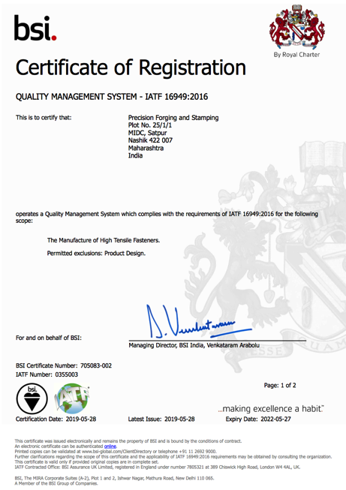
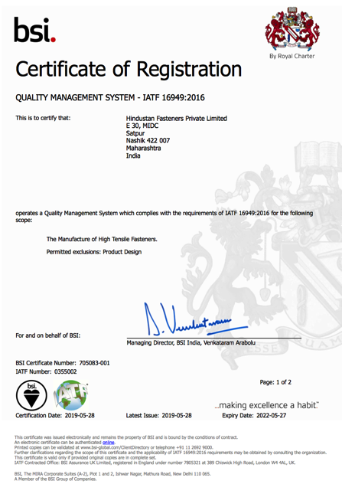

Slide 4
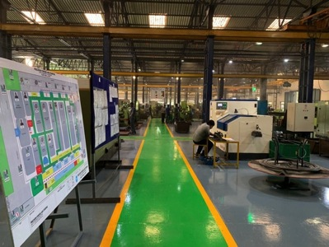
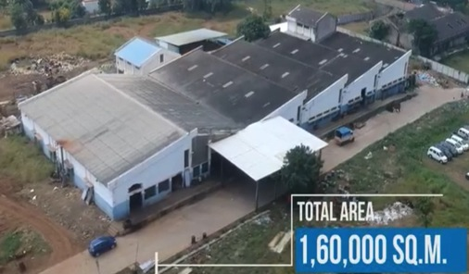
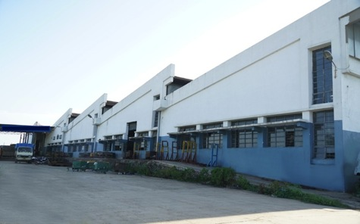
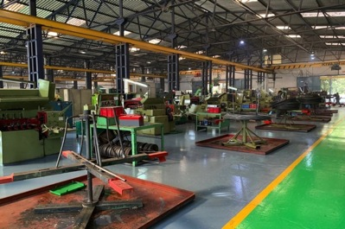
Manufacturing Plant locations
4 plants in Satpur MIDC , Nashik ,Maharashtra spread over an area of 1,60,000 Square Meters

Slide 5
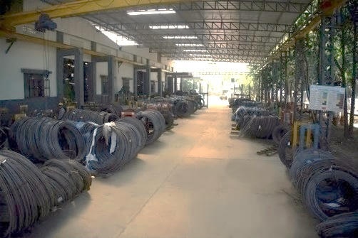
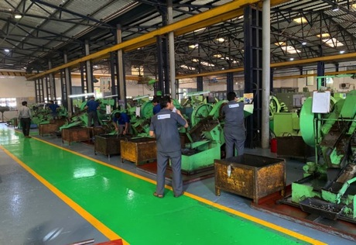
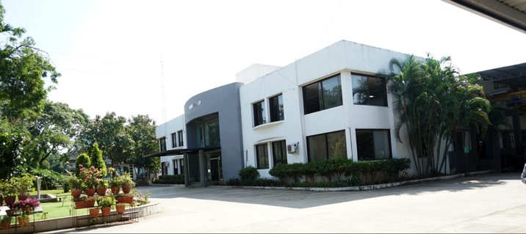

Slide 6
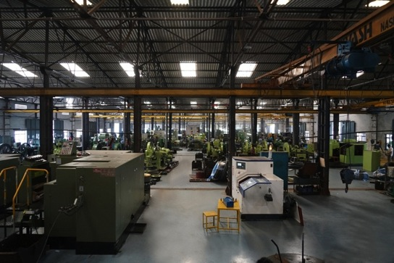
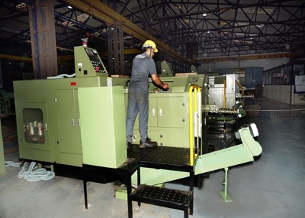

Slide 7
Vision
To be the leading fasteners manufacturer both domestically and globally by providing complete fastening solutions under one roof.
Mission
We strive to be a customer-centric, and quality driven fastener manufacturer that provides complete fastening solutions, that are tailored to individual customer needs.

Slide 8
Our Core Values
Value
Service
Quality
Team
We create value through innovation and cost effectiveness. Not just provide fasteners but expertise in complete fastening solutions.
To be one stop solution to all fastening requirements. We strive to provide highest level of client service through on time delivery every time.
We are committed to ZERO DEFECT by removing quality hindrances at occurrence stage, not at inspection.
Together we make the difference through commitment and continuous skill enhancement.

Slide 9


























Our Esteemed Customers

Slide 10
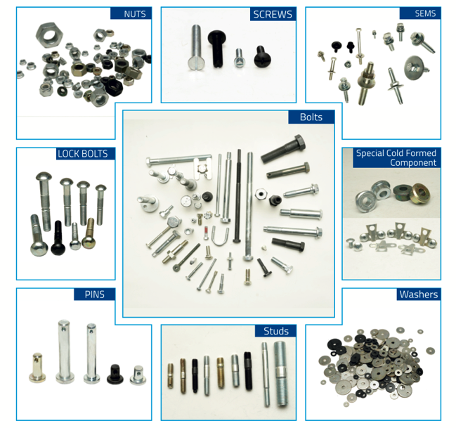
Product Range
We manufacture over 1,00,000 varieties of standard & special fasteners.
Components manufactured to Customers’ exact designs and specifications, OEM Drawings, Customer Designs
Reverse Engineering from existing samples

Slide 11
Product Range- BOLTS AND SCREWS
  Range- M4 to M24, Length from 10 mm to 300 mm
Hex Bolts

Slide 12
Banjo Bolts
Rocker Arm Bolts
Pivot Bolts
U Bolts
Position Screws

Slide 13
Eccentric Bolt
Flange Bolts
Weld screws
Gear Bolt

Slide 14
Carriage Bolt
D head Bolts
Wheel Bolt
Eye Bolt
Cylinder Head Bolt
Wheel Bolt

Slide 15
Plumber Block Cover Bolt
Double End Bolt
Camber Cam Bolt
Square Head Screw

Slide 16
Self tapping Screws
Slotted Screws
Allen Bolts
Square Head Screws
Six lobe screw
External 6 lobe bolt

Slide 17
Drilled Pin
Spl faced bolt
Battery Bolts
SS Plug
Special allen bolt

Slide 18
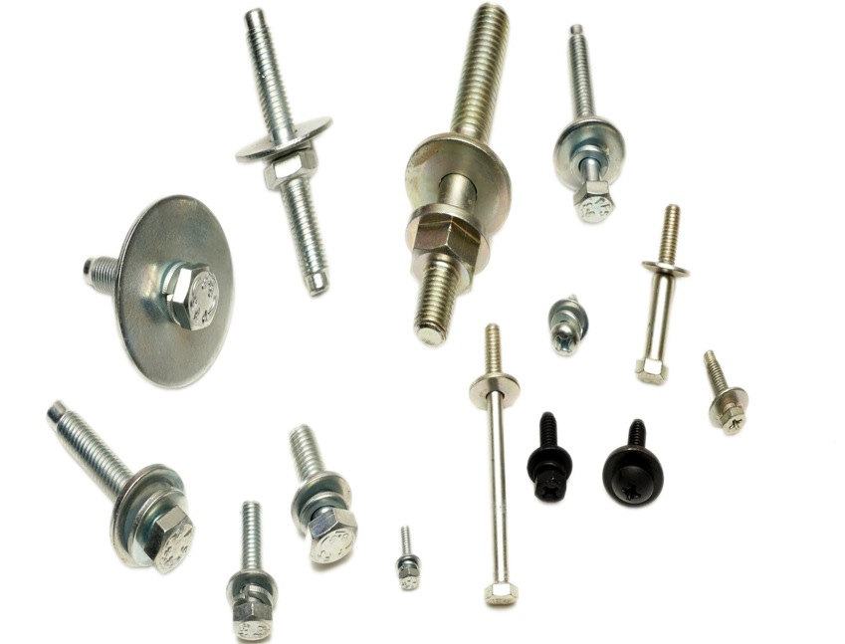
Combi Screws/ SEMS

Slide 19
Studs

Slide 20
Product Range- Nuts
Hex Nuts

Slide 21
Wheel Nuts
Nylock Nuts
Round Weld Nuts
U nut/ Lock Nut

Slide 22
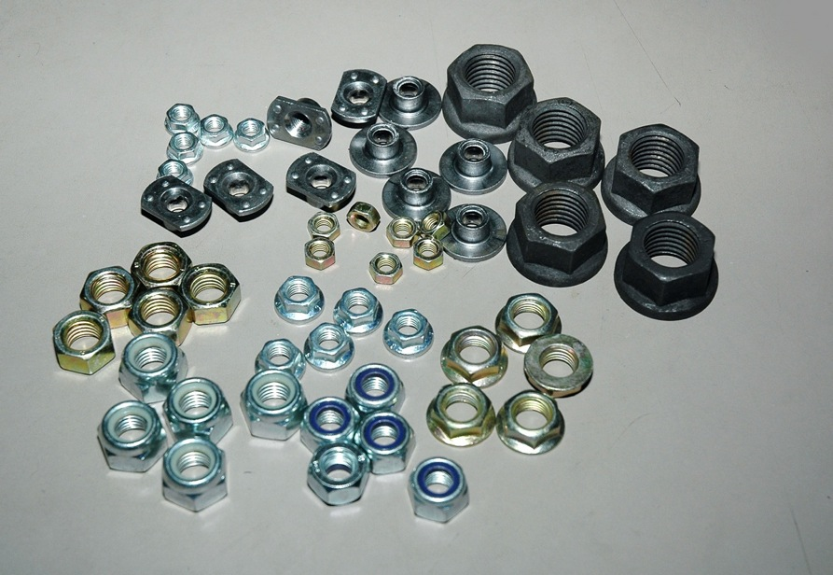
Flange Nuts, Nylock Nuts, T Weld Nuts

Slide 23
Cage Nuts
Rivet Nuts
Square Weld Nuts
T weld Nut
Round Weld Nut
Hex Weld Nuts

Slide 24
Castle Nut
Spl nut earth plate
Spl blind rivet nut (Auto)
Sleeves
Thin Nuts

Slide 25
Sleeves
Lock Bolt
Butterfly Brackets
Collar Sleeves

Slide 26
Hanger Rods

Slide 27
Washers
Flat Washers
Spring Washers
Camber Cam Washers
Conical Washers

Slide 28
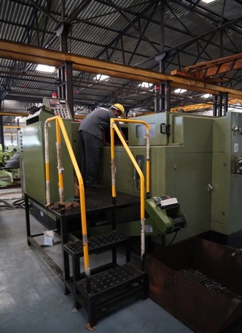
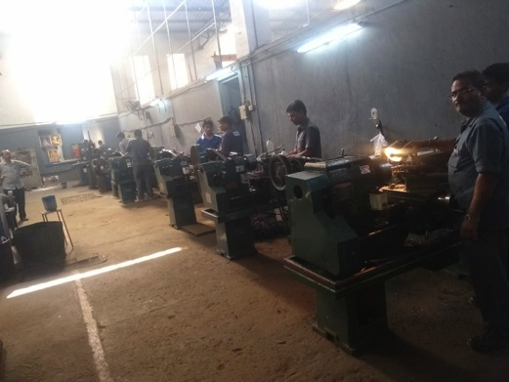
MANUFACTURING CAPABILITIES
All operations are done in house- giving complete control over quality. In-house processes such as heat treatment, surface finishing, tooling- all enable Hindustan Fasteners to have complete control over the final product.
Tooling Department

Slide 29
RM inspection
Cold Forging
Surface Treatment
Thread Rolling
Heat Treatment
Eddy Current Testing
Final Inspection
Packaging and Dispatch
Bolts, Screws
Plating
Secondary Operations
Cold Forging
Nut Tapping
Heat Treatment
RM inspection
Final Inspection
Packaging and Dispatch
Nuts
Tooling
All Production operations are under one management control

Slide 30
Complete in- house Secondary Operations
Automatic Tapping
Slot Milling
Grinding
Grooving
Special pointing
CNC Machining
Bolt head trimming
Single/Double washer assembly thread rolling for SEMS (Combination) screws and bolts
Crimping of Nuts
Drilling

Slide 31
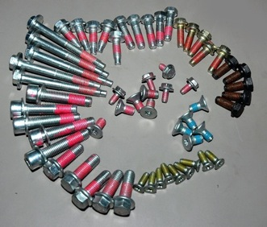
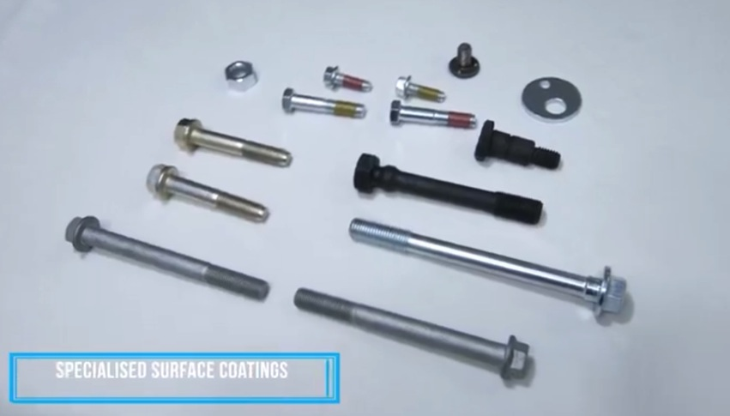
Range of Coatings
We excel in a variety of coatings like Zinc Electroplating, Zinc Phosphating, Aluminium Zinc Flake Coating, Hot Dip Galvanizing, Loctite microencapsulation, which are all done in-house.

Slide 32
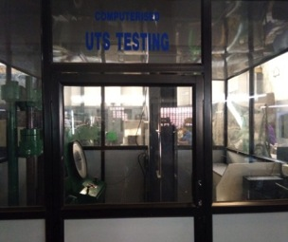
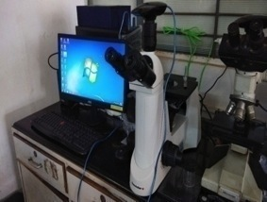
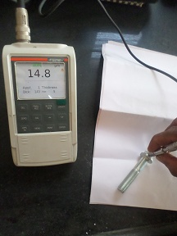
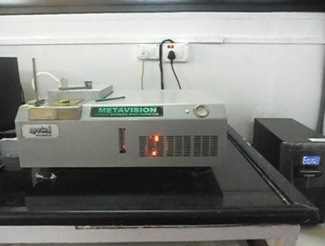
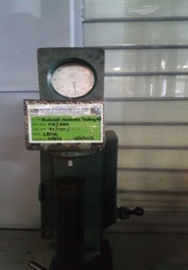
INSPECTION AND TESTING FACILITIES
Microstructure testing with image analyser
UTM Testing machine
Rockwell Hardness Tester
DFT meter for plating thickness testing
Spectrometer for chemical analysis

Slide 33
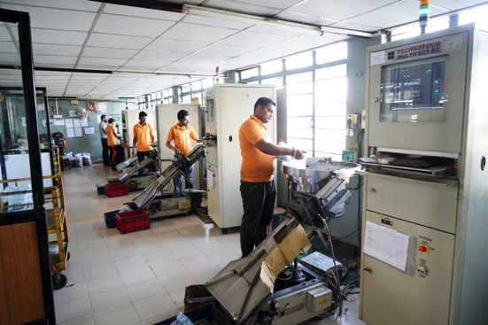
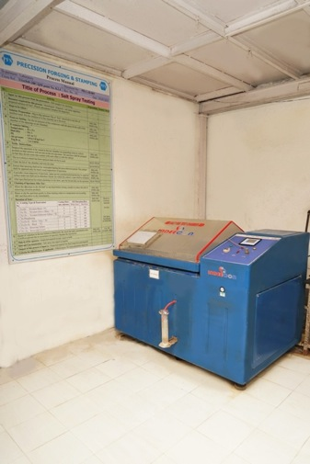
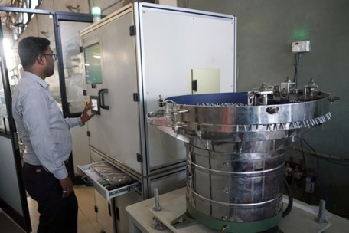
Eddy Current Sorting
Salt Spray Testing
Optical Sorting

Slide 34
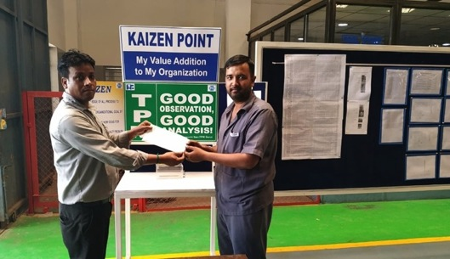
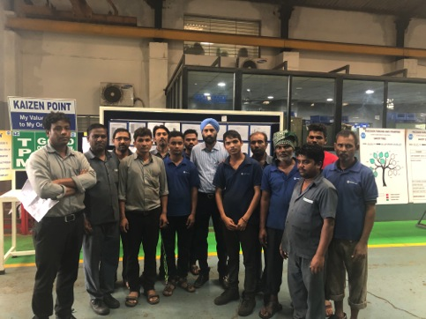
KAIZEN- CONTINUOUS IMPROVEMENT APPROACH
Involvement of all team members in continuous improvement initiatives with weekly appreciation of significant improvements implemented.

Slide 35
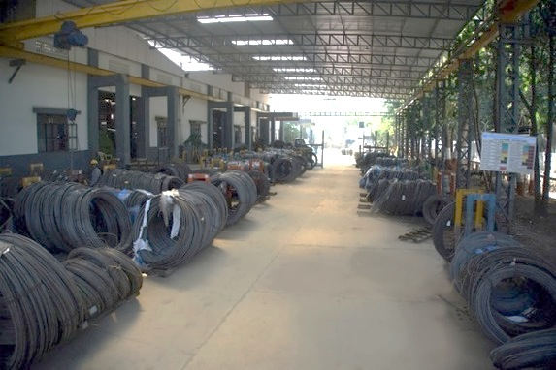
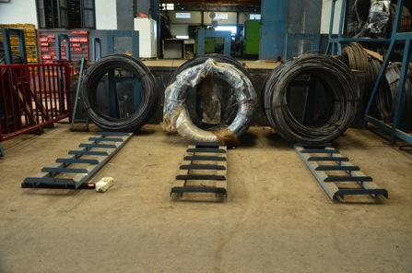
Incoming Inspection
Separate area specified for Ok and Rejected material
Rejected material is placed in rejection area and on detailed analysis obtained from supplier
Record of incoming coil and metallurgical test report verified by senior authorities as a part of layered audit

Slide 36
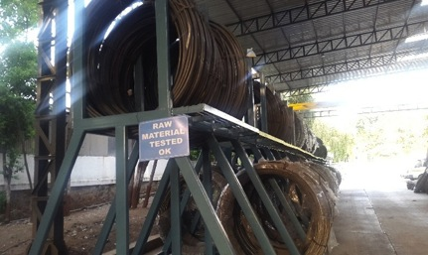
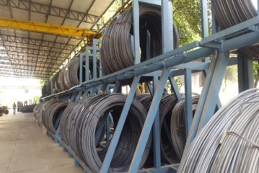
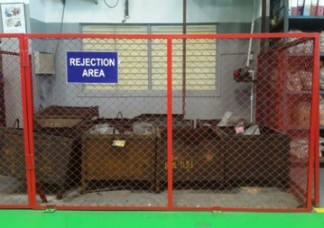
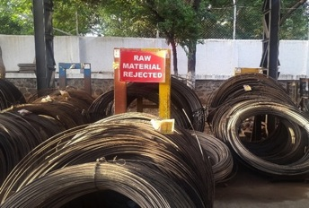
Incoming Material Rack | Accepted Material Storage
Rejected Raw Material Storage | Rejected WIP material storage

Slide 37
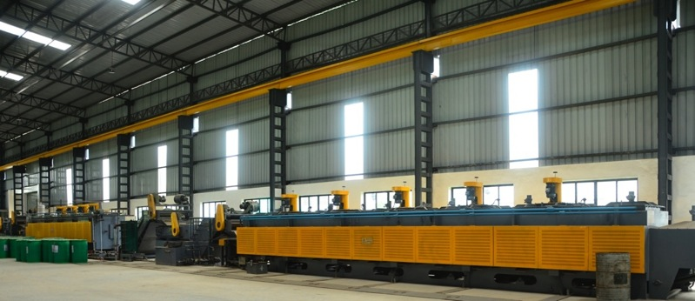
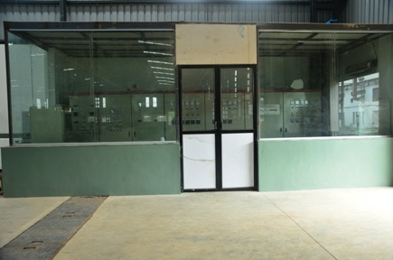
HEAT-TREATMENT
Continuous Heat Treatment furnaces are working on SCADA with necessary pokayoke control arrangements for every parameter.

Slide 38
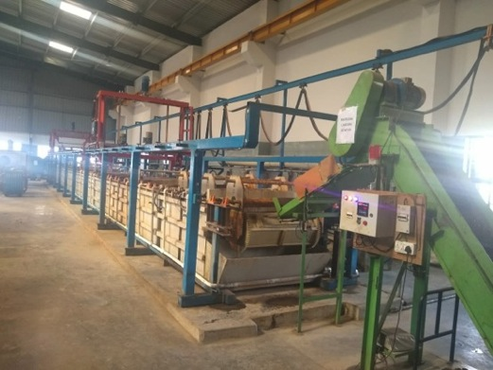
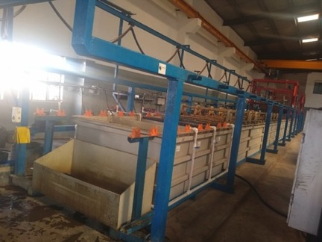
PLATING PROCESS
Automatic plating is having PLC control which allows us to have complete control over every parameter

Slide 39
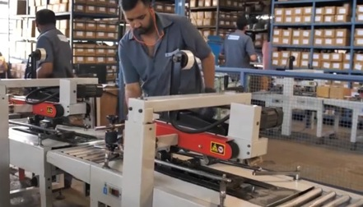
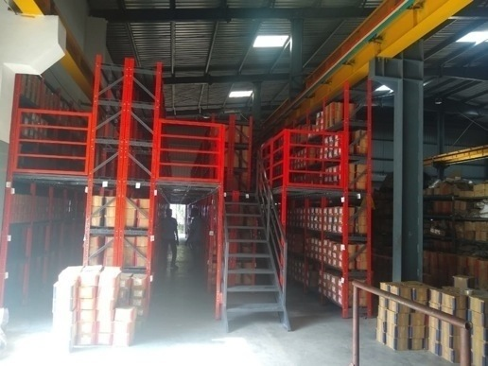
PACKAGING AND DISPATCH
Systematic dispatch material store where minimum inventory level is maintained for individual customer as per consumption patterns to avoid critical shortages.
Automated Packaging lines
Dispatch Material Storage Warehouse

